Slide 1

Opportunity Dashboard

Slide 2
Team Members
Om Boddawar
Jayshri Sharma
Hamza
Tina Negi
Waseem Ahmed Mohammed

Slide 3
Key Sales Metrics
Expected Amount: Total projected revenue from open deals
Active Opportunities: Number of open opportunities
Conversion Rate (%): (Won / Total Created) × 100
Win Rate (%): (Won / (Won + Lost)) × 100
Loss Rate (%): (Lost / Total) × 100
Trend Analysis: Monthly trend of created, won, and lost deals
Expected vs Forecast: Revenue comparison over time
Active vs Total Opportunities: Open vs overall deal count
Closed Won vs Total Opportunities: % of total opportunities won
Closed Won vs Total Closed: Win % among closed deals
Expected Amount by Type: Revenue by opportunity category
Opportunities by Industry: Count or value by industry segment

Slide 4
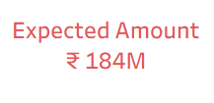
Expected Amount
📌 Definition:
Total revenue expected from opportunities based on probability.
🎯 Purpose:
Supports revenue forecasting and planning.

Slide 5
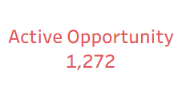
Active Opportunities
📌 Definition:
Opportunities marked as Open and in progress within the sales pipeline.
🎯 Purpose:
Monitor and drive potential sales in progress.

Slide 6
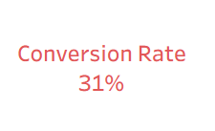
Converted Opportunities
📌 Definition:
Opportunities that originated from leads and converted.
🎯 Purpose:
Measures lead-to-opportunity conversion performance.

Slide 7
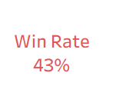
Win Rate
📌 Definition:
(Closed Won / (Closed Won + Closed Lost)) × 100.
🎯 Purpose:
Assesses efficiency of opportunity closing.

Slide 8
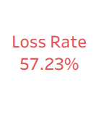
Loss Rate
📌 Definition:
(Closed Lost / (Closed Won + Closed Lost)) × 100.
🎯 Purpose:
Identifies inefficiencies or potential improvement areas.

Slide 9
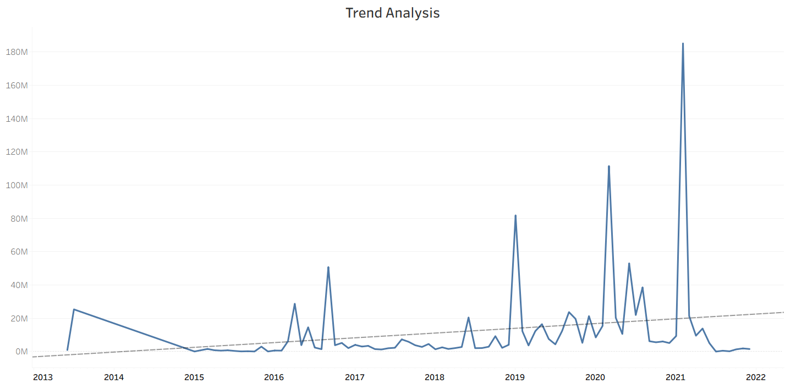
Trend Analysis
📌 Definition:
Monthly trend of created opportunities.
🎯 Purpose:
Understand sales growth patterns.

Slide 10
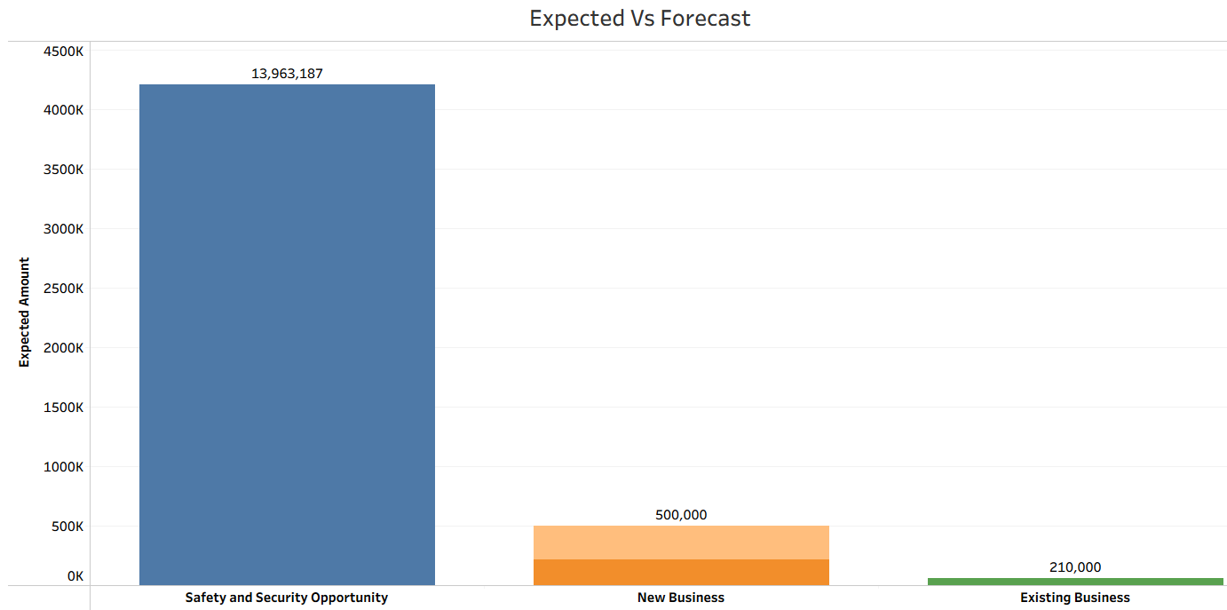
Expected Vs Forecast
📌 Definition:
Running total comparison of expected revenue and forecast over time.
🎯 Purpose:
To compare projected sales outcomes (expected) with data-driven predictions (forecast) for more accurate planning and decision-making.

Slide 11
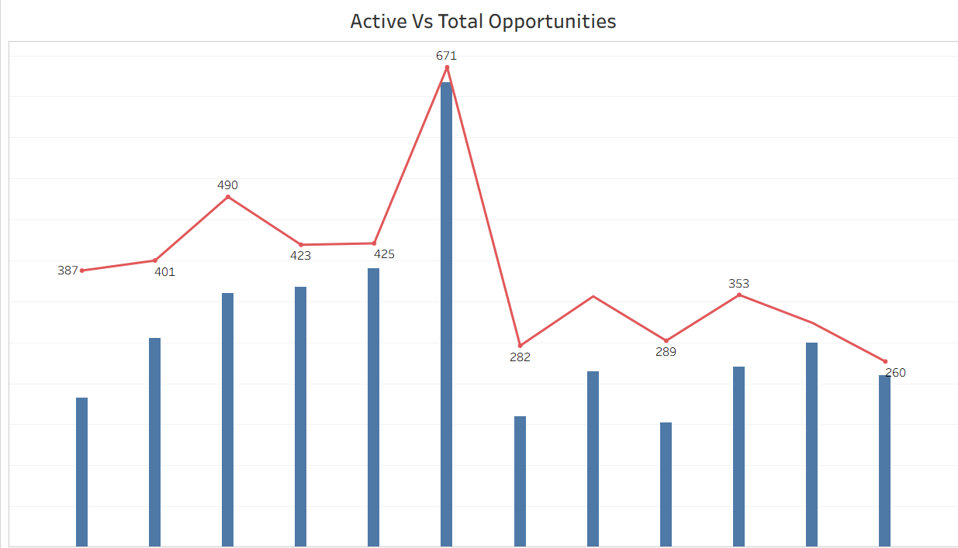
Active Vs Total Opportunities
📌 Definition:
Cumulative active vs. total opportunities trend
🎯 Purpose:
Compares active deals to total opportunities to assess pipeline health and sales activity.

Slide 12
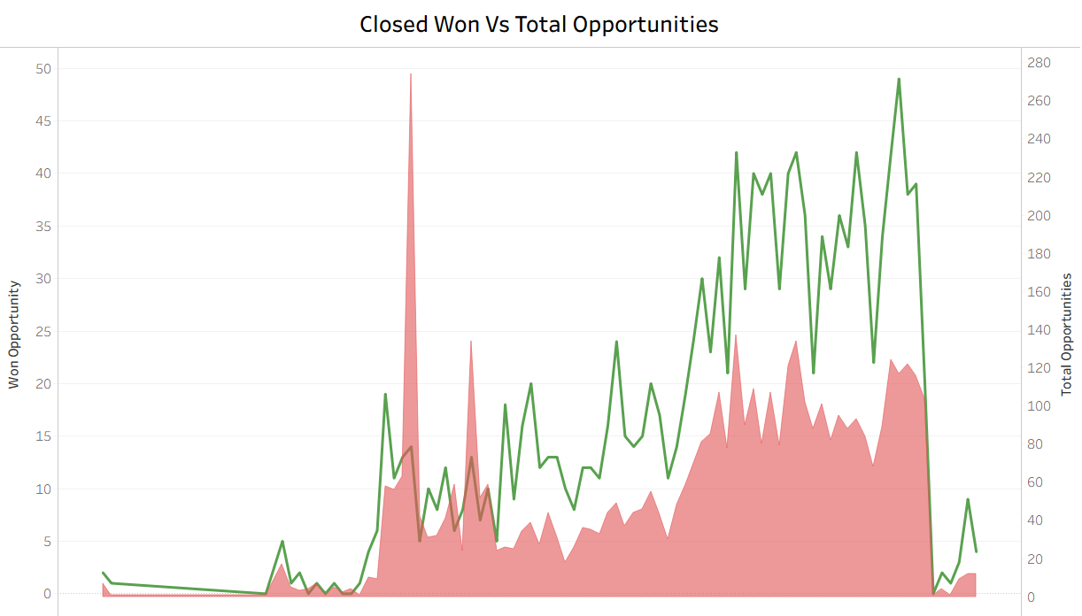
Closed Won vs Total Opportunities
📌 Definition:
Share of closed won deals out of total opportunities.
🎯 Purpose:
Reflects general sales conversion efficiency.

Slide 13
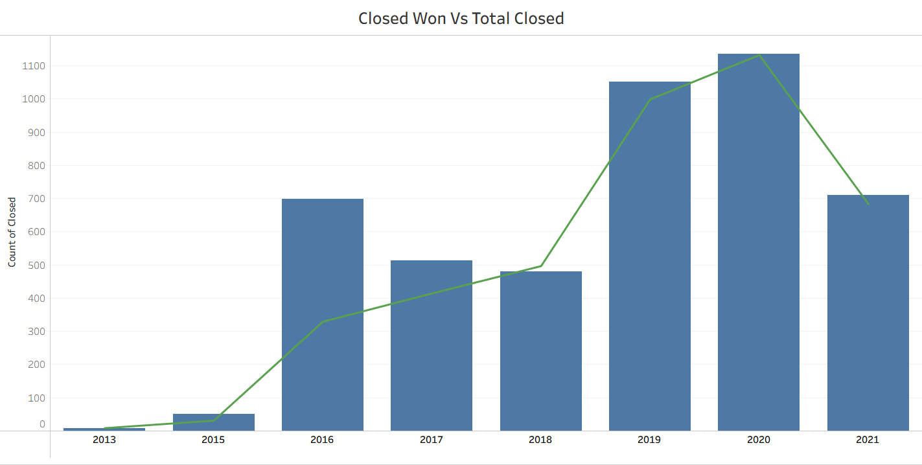
Closed Won vs Total Closed
📌 Definition:
Closed won divided by total closed (won + lost).
🎯 Purpose:
Measures win success among finalized deals.

Slide 14
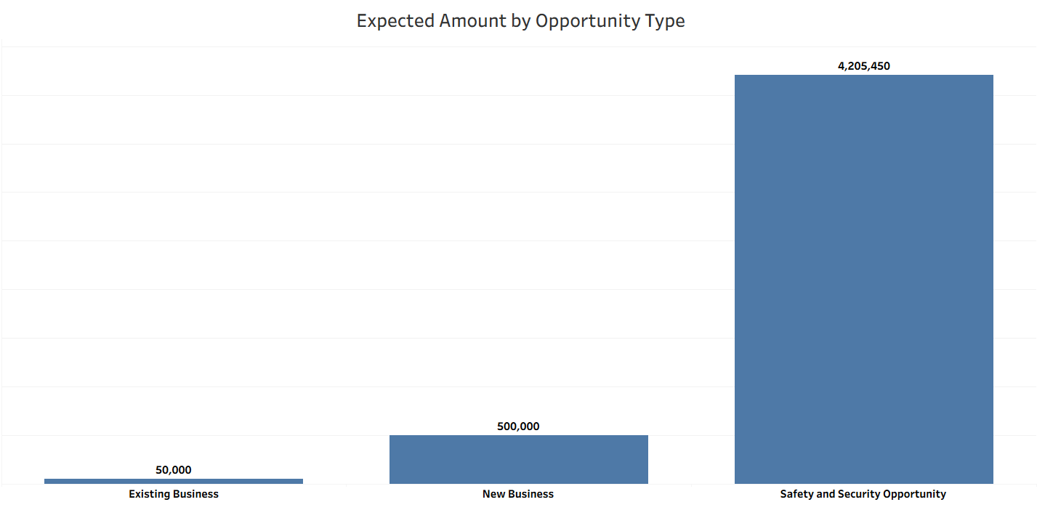
Expected Amount by Opportunity Type
📌 Definition:
Expected revenue broken down by opportunity type.
🎯 Purpose:
Reveals most valuable opportunity types.

Slide 15
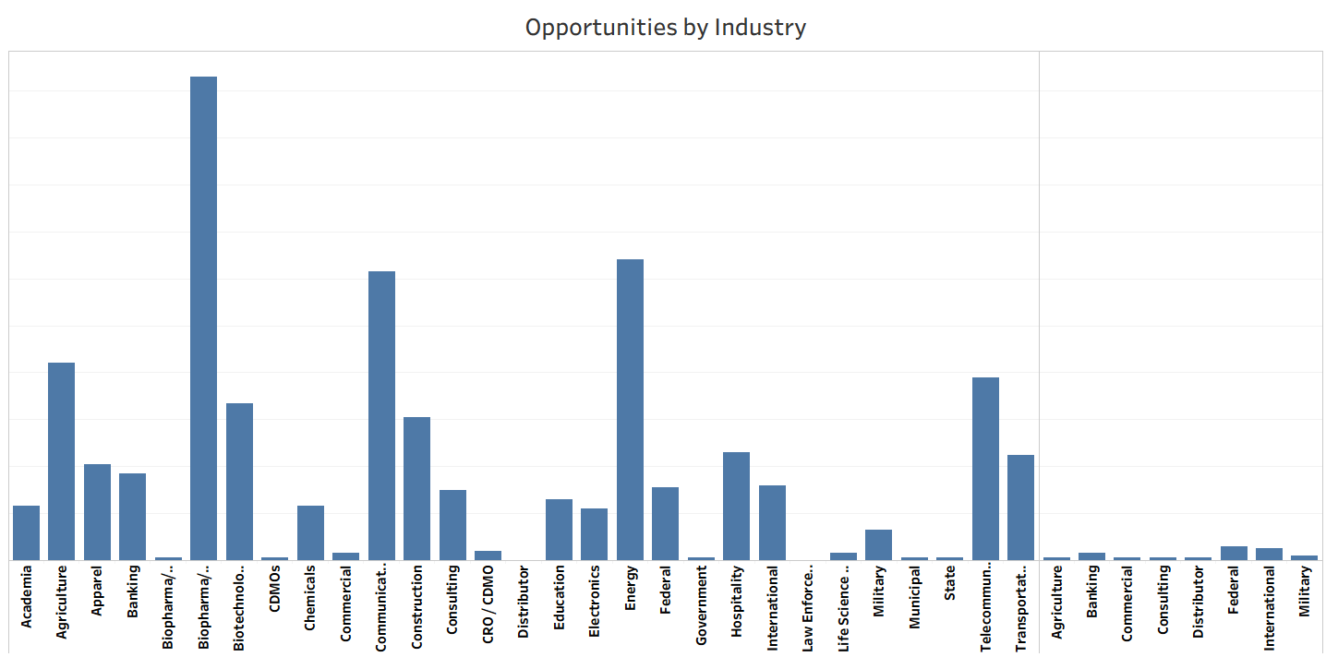
Opportunities by Industry
📌 Definition:
Categorizes sales opportunities based on client industry to identify key market segments.
🎯 Purpose:
Shows which industries drive the most opportunities to guide targeting and strategy.

Slide 16
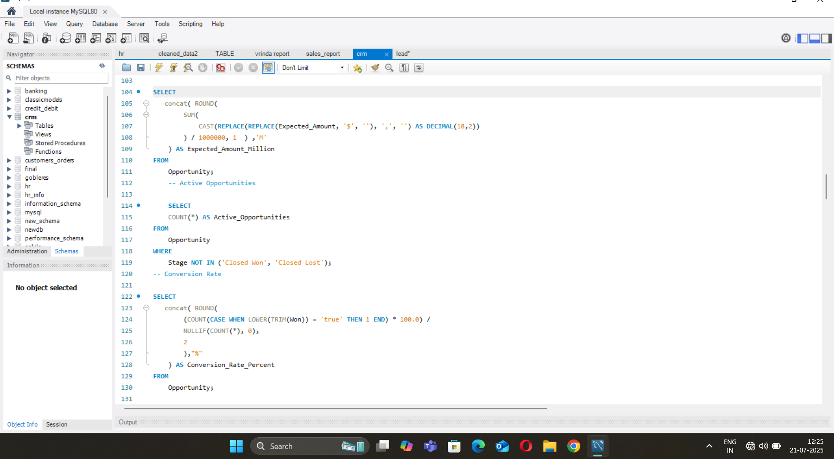
SQL Queries for Opportunity

Slide 17
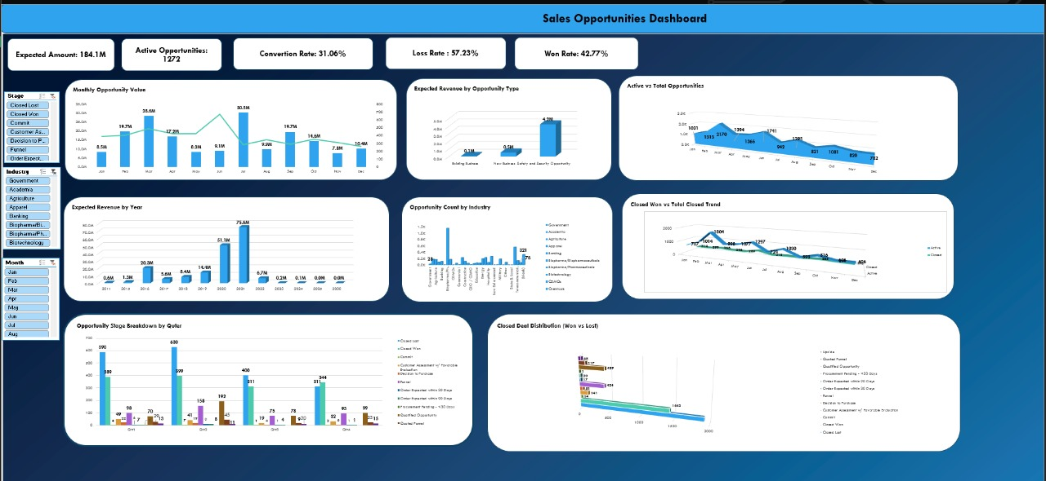
Excel Dashboard

Slide 18
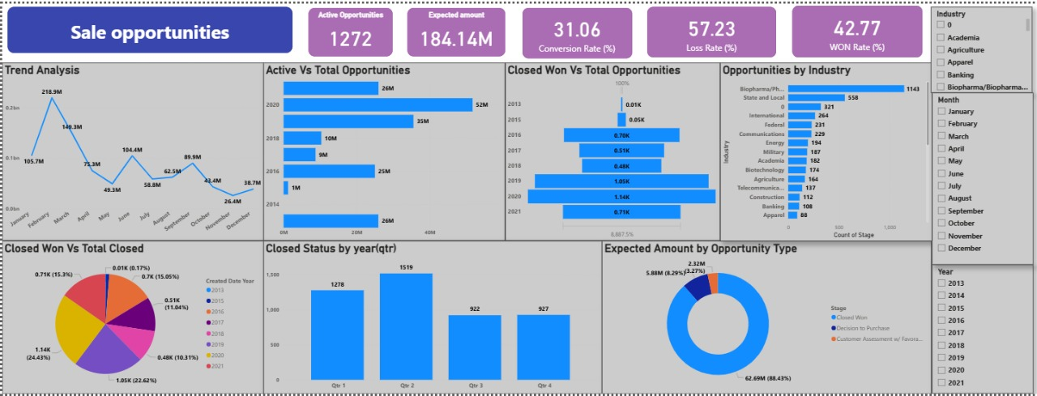
Power Bi Dashboard

Slide 19
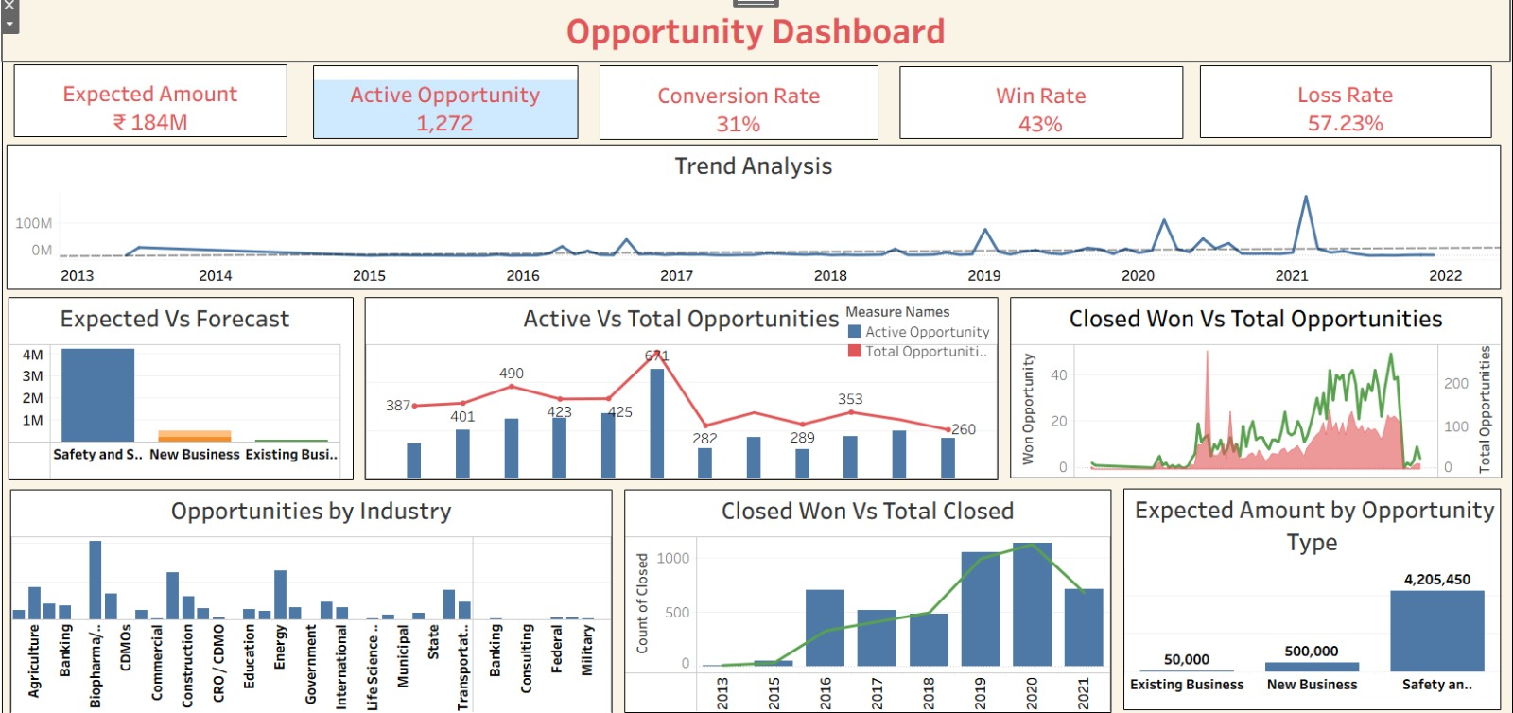
Tableau Dashboard

Slide 20
Lead Dashboard

Slide 21
Lead Performance Metrics
Total Leads: Count of all generated leads
Expected Amount (Converted Leads): Projected revenue from converted leads
Conversion Rate (%): (Converted Leads / Total Leads) × 100
Converted Accounts: Number of leads converted to accounts
Converted Opportunities: Number of leads converted into opportunities
Leads by Source: Distribution of leads by acquisition channel
Leads by Industry: Lead count segmented by industry
Leads by Stage: Pipeline stage distribution of all leads

Slide 22

Total Leads
📌 Definition:
Count of all leads captured.
🎯 Purpose:
Shows the volume of lead acquisition.

Slide 23

Expected Amount
📌 Definition:
Total revenue expected from opportunities based on probability.
🎯 Purpose:
Supports revenue forecasting and planning.

Slide 24

Conversion Rate (%)
📌 Definition:
(Leads Converted to Customers / Total Leads) × 100.
🎯 Purpose:
Indicates quality and effectiveness of lead conversion.

Slide 25

Converted Accounts
📌 Definition:
Number of leads that created accounts.
🎯 Purpose:
Tracks success in transitioning leads into active customers.

Slide 26

Converted Opportunities
📌 Definition:
Leads converted into opportunities.
🎯 Purpose:
Measures initial pipeline conversion.

Slide 27
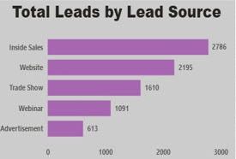
Leads by Source
📌 Definition:
Distribution of leads by acquisition channel.
🎯 Purpose:
Identifies top-performing lead sources.

Slide 28
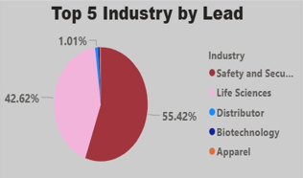
Leads by Industry
📌 Definition:
Distribution of leads by industry.
🎯 Purpose:
Highlights the most engaged industries.

Slide 29
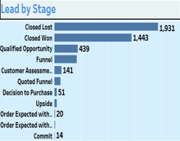
Leads by Stage
📌 Definition:
Count of leads by current lead stage.
🎯 Purpose:
Provides insight into lead progression and bottlenecks.

Slide 30
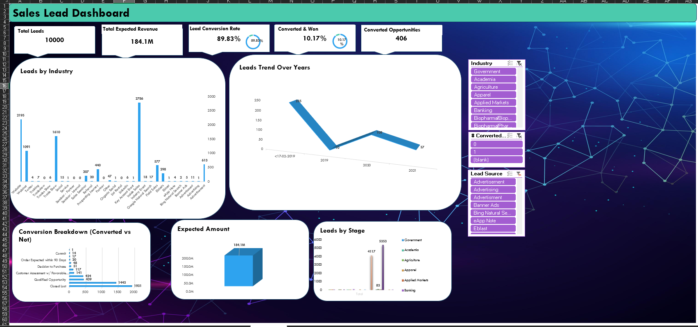
Excel Dashboard for Lead

Slide 31
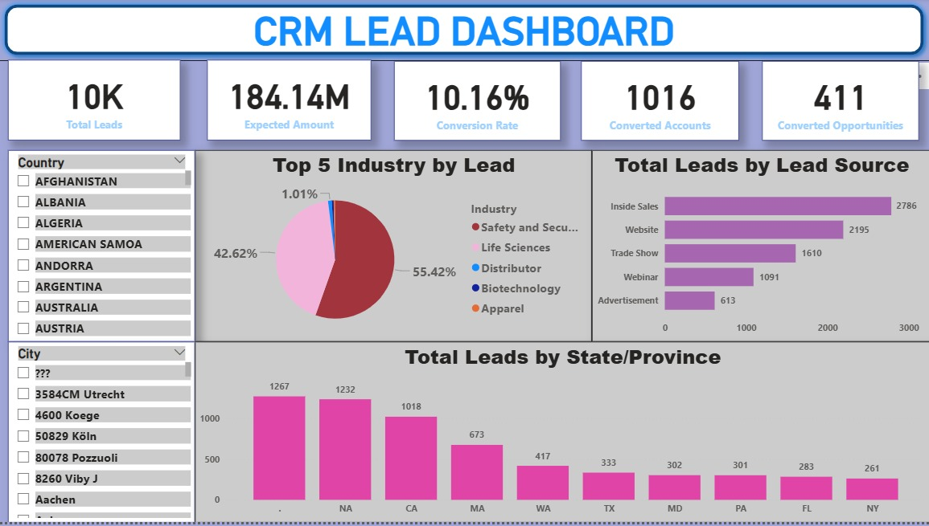
Power Bi Dashboard for Lead

Slide 32
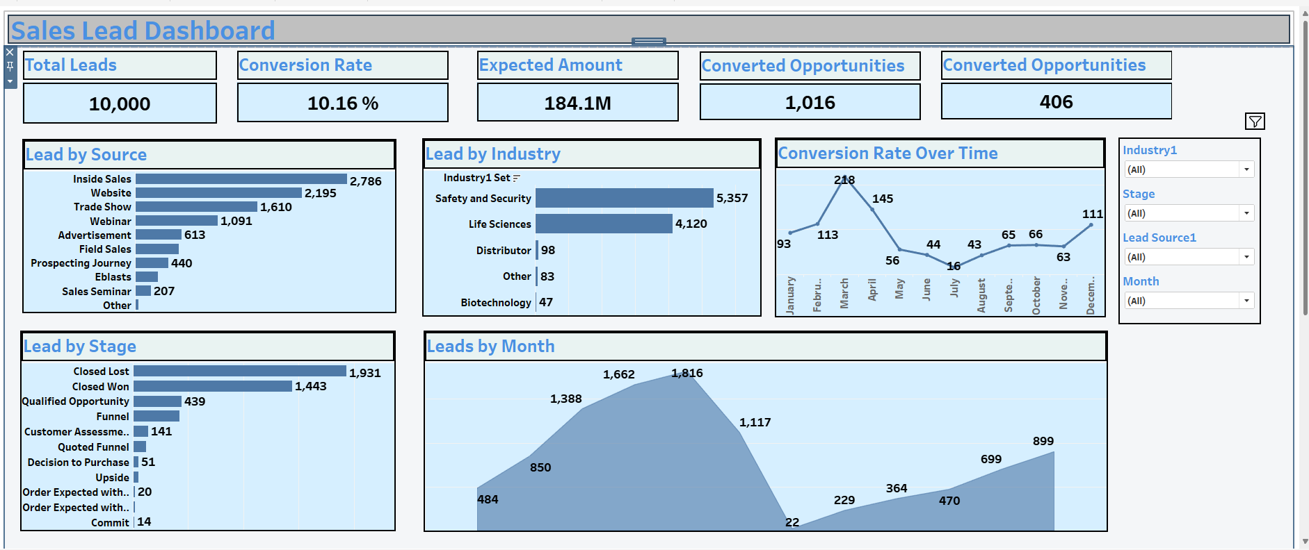
Tableau Dashboard for Lead

Slide 33
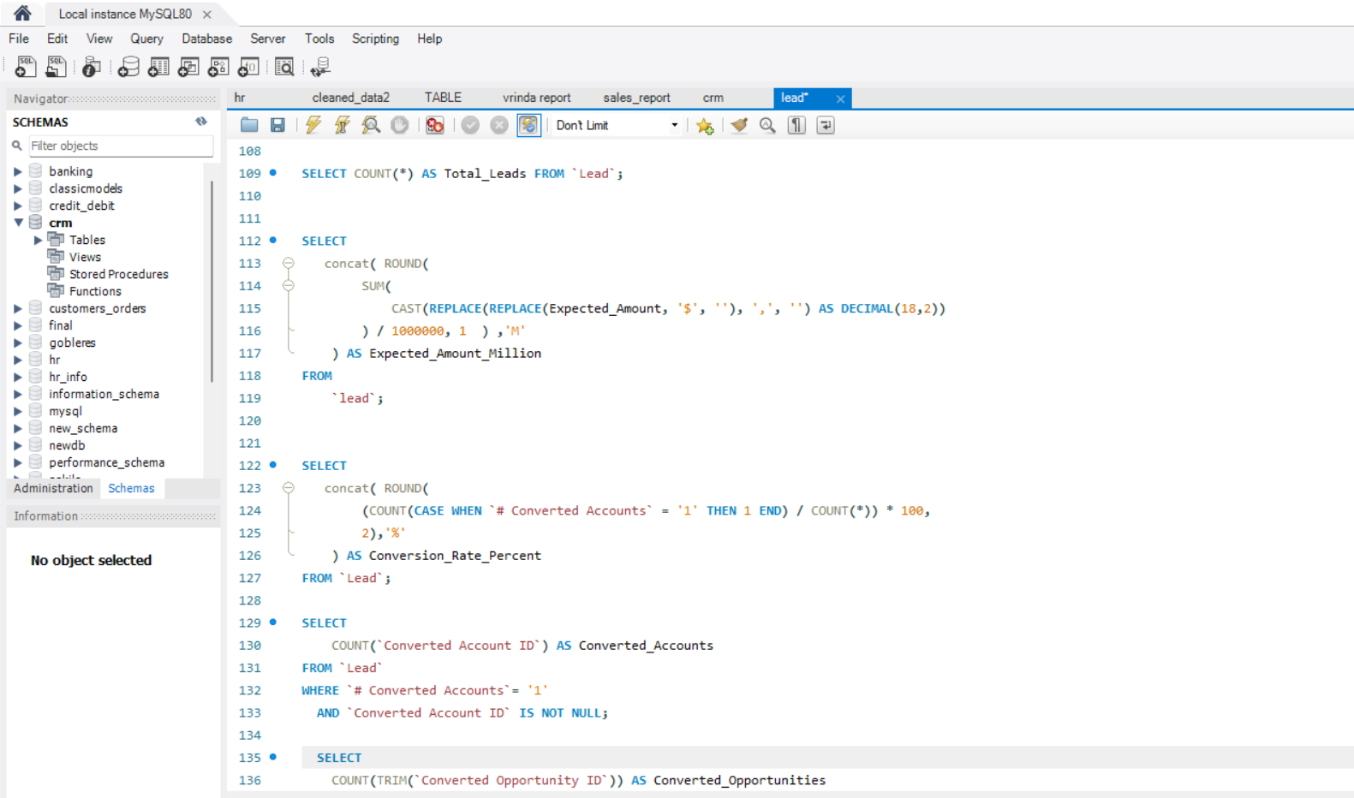
SQL Query for Lead

Slide 34
Optimizing Sales Performance
This presentation highlights key strategies for enhancing sales performance by improving opportunity conversion rates and win rates. By implementing effective follow-up techniques and conducting a comprehensive analysis of sales processes, organizations can significantly boost their sales effectiveness and drive growth. The focus on these elements ensures a systematic approach to optimizing sales outcomes.

Slide 35



Improving Follow-ups
Implement Robust Strategies
Nurture Leads
Automate Follow-ups
Engage with potential clients consistently to build relationships and trust, which are crucial for higher conversion rates.
Utilize technology to automate follow-up communications where appropriate, ensuring timely engagement without overwhelming sales teams.
Develop and enforce strong follow-up processes to nurture leads effectively, increasing the likelihood of converting opportunities into sales.

Slide 36



Analyzing Lost Deals
To improve sales strategies, it is crucial to analyze lost deals systematically. Conducting post-mortem analyses helps identify the underlying reasons for losses, while recognizing common pitfalls can lead to more focused training. Ultimately, the goal is to implement changes that reduce the loss rate and boost the win rate.
Identify Common Pitfalls
Conduct Post-Mortem Analyses
2
Recognize mistakes that lead to lost deals.
1
3
Reduce Loss Rate
Analyze reasons for loss to identify patterns.
Implement changes to improve overall success.

Slide 37

Focusing on High-Value Opportunities
1
Prioritize High-Value Types
2
Reevaluate Lead Qualification
3
Allocate Resources Effectively
Identify and concentrate resources on high-value opportunities and customer segments that promise the best return on investment.
Regularly assess and adjust lead qualification criteria to filter out unproductive leads.
By focusing on high-value opportunities, optimize resource allocation for maximum impact on sales performance.

Slide 38
Challenges faced during Internship Program
Time Constraints: Managing internship tasks alongside job and course commitments.
Practical Exposure Gap: Applying theoretical knowledge from the course in real-world scenarios.
Tool Proficiency: Struggling with unfamiliar tools like SQL, Power BI, or Tableau.
Limited Guidance: Less mentorship in virtual internships compared to in-person ones.
Communication Barriers: Collaborating effectively in remote or hybrid teams.

Slide 39
Thank You

